Slide 1
Data Visualisation
Using Tableau
Arthik Daniel das11e@uwindsor.ca 104742468
Kiranjot Kaur kaur13u@uwindsor.ca 104871416
Pavan Ganga posina@uwindsor.ca 104907887
Notes:
Pavan’s email id.

Slide 2
Agenda
Why Data Visualisation?
Why Tableau?
What We Learned?
Data Preparation
Visual Analytics Features
Dashboards & Data Stories
Learning Curve

Slide 3
Why Data Visualisation?

Slide 4
Why Data Visualisation?
To help us easily understand the Significance of Data by placing it in a Visual Context. It is the defacto standard in Business Intelligence (BI)
What exactly are we looking for:
Patterns
Trends / Predictions
Co-relations
Indicators / Alerts / Key Performance Indicators (KPI)

Slide 5

Why Tableau?

Slide 6
Why we selected Tableau?
Qlikview & Tableau are the most popular commercially used BI tools for trends & forecasting
Supports for connectivity to Big Data / Any Data and refreshes data automatically
Smart and Interactive Dashboards >>> Allows for drilldowns into data for querying & analysis

Slide 7
What We Learned?
Data Preparation

Slide 8
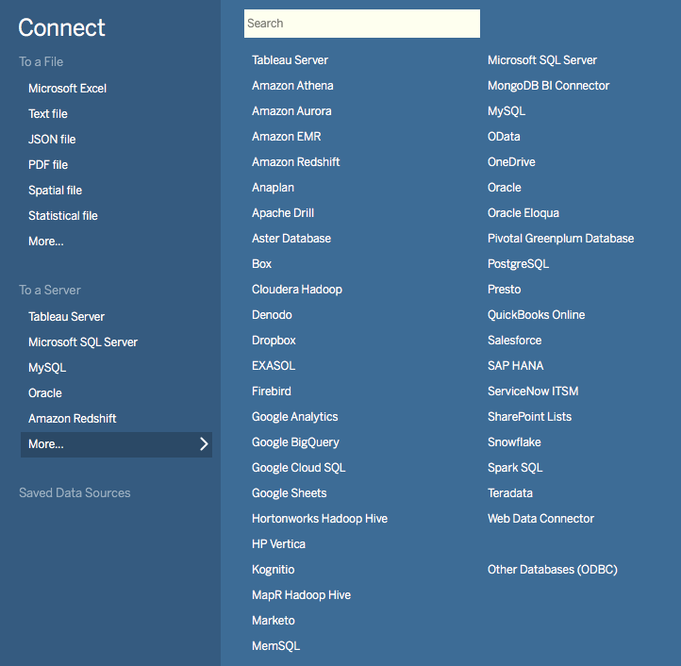
Connect to Data Sources
Allows to connect to single / multiple sources.
Connection Types:
Live: Connects to Live Data Source
Extract: Connects to Local Data Extract
Data Interpreters allow to clean up data sources that aren’t cleaned up.

Slide 9
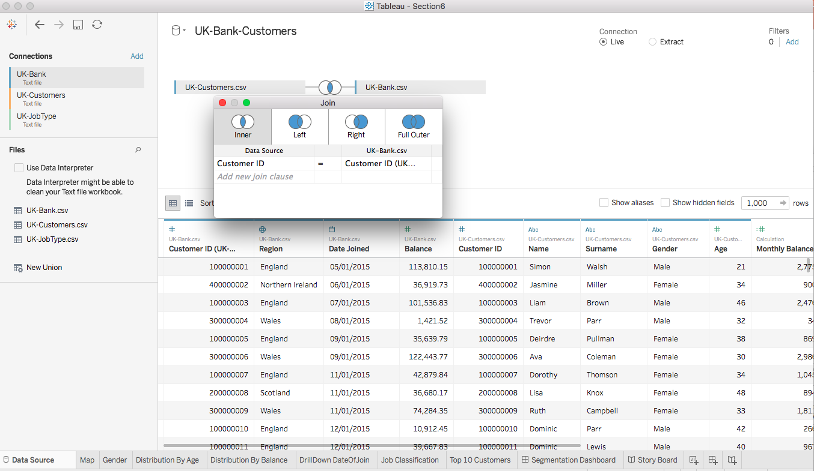
Datasource Joins
Outer Join
Inner Join
Left Join
Right Join

Slide 10
Data Blending
An alternate approach to create JOINS
Use Data Blending when any one of the following cases are true:
When your datasets have different levels of granularity
When your data comes from disparate data sources
When you simply cannot do a join for any other reason

Slide 11
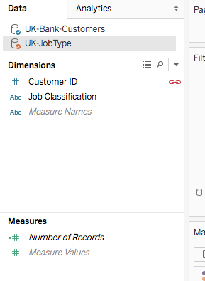
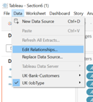
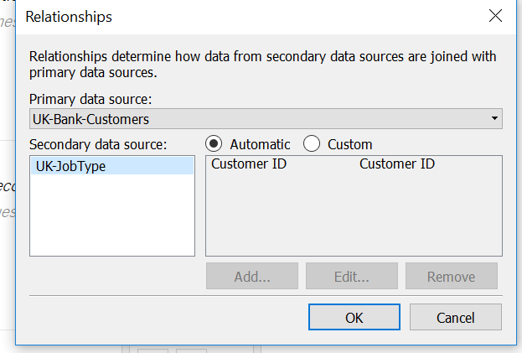
Data Blending - continued

Slide 12
What We Learned?
Visual Analytic Features
Notes:
Don't you want to know where your most profitable customers come from?

Slide 13
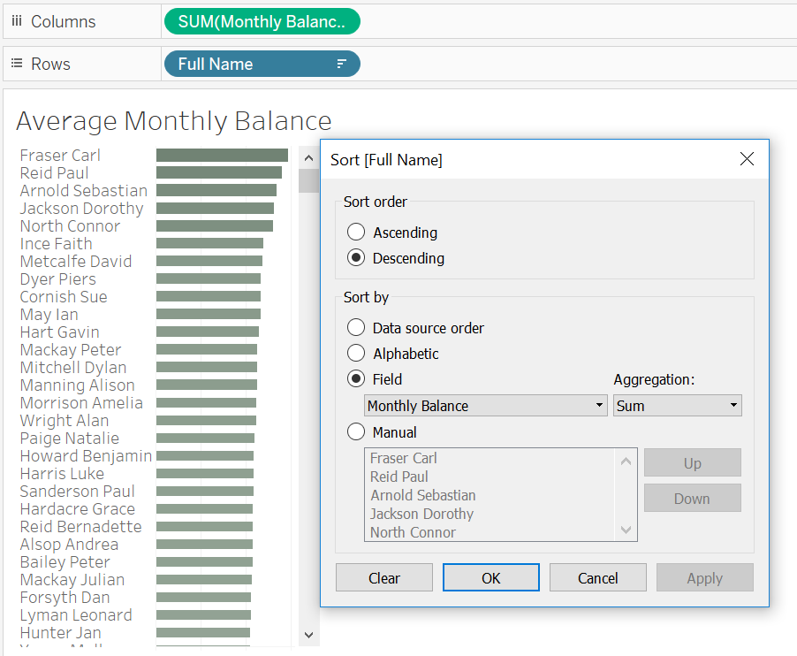
Sorting
Allows us to Sort our Visualization in ascending or descending

Slide 14
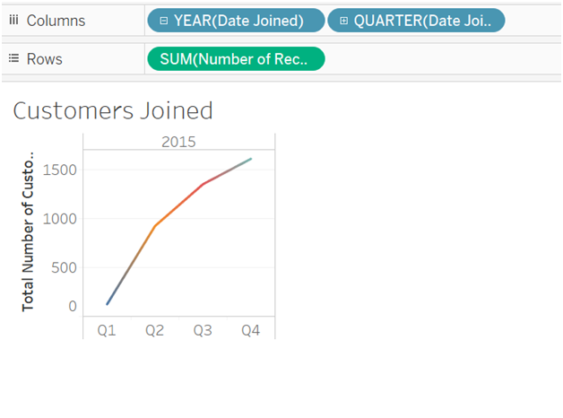
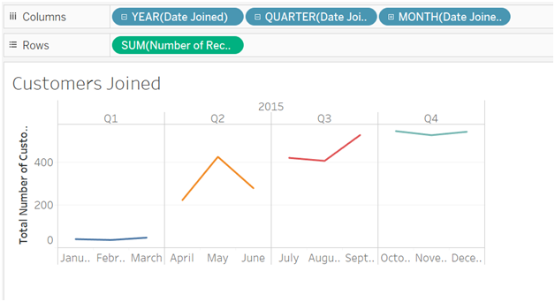
Drilldown
Allows for hierarchies to display data using categories and sub-categories.
Customer joining date is used to drilldown to review the yearly, quarterly, monthly data.

Slide 15
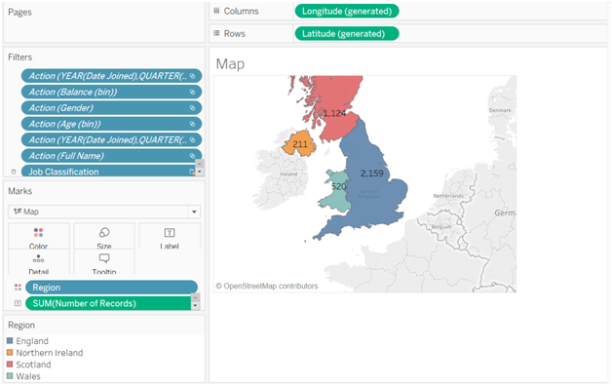
Mapping / Geocoding
Mapping is way of representing our data or visualization on the basis of the regions.

Slide 16
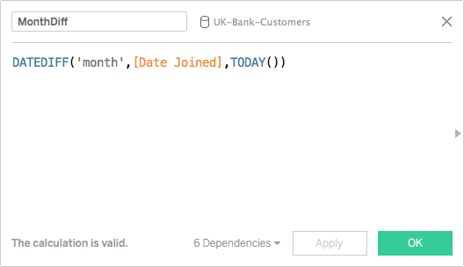
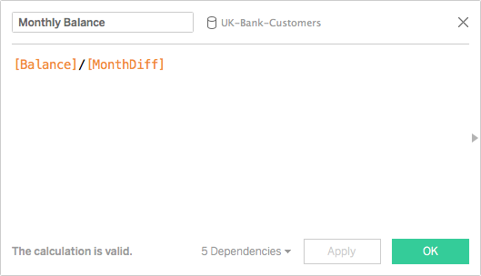
Calculated Fields
Allows for Creation of New fields that are not necessarily readily available in our datasets
These fields are save as part of our data source.

Slide 17
What We Learned?
Dashboard & Stories

Slide 18
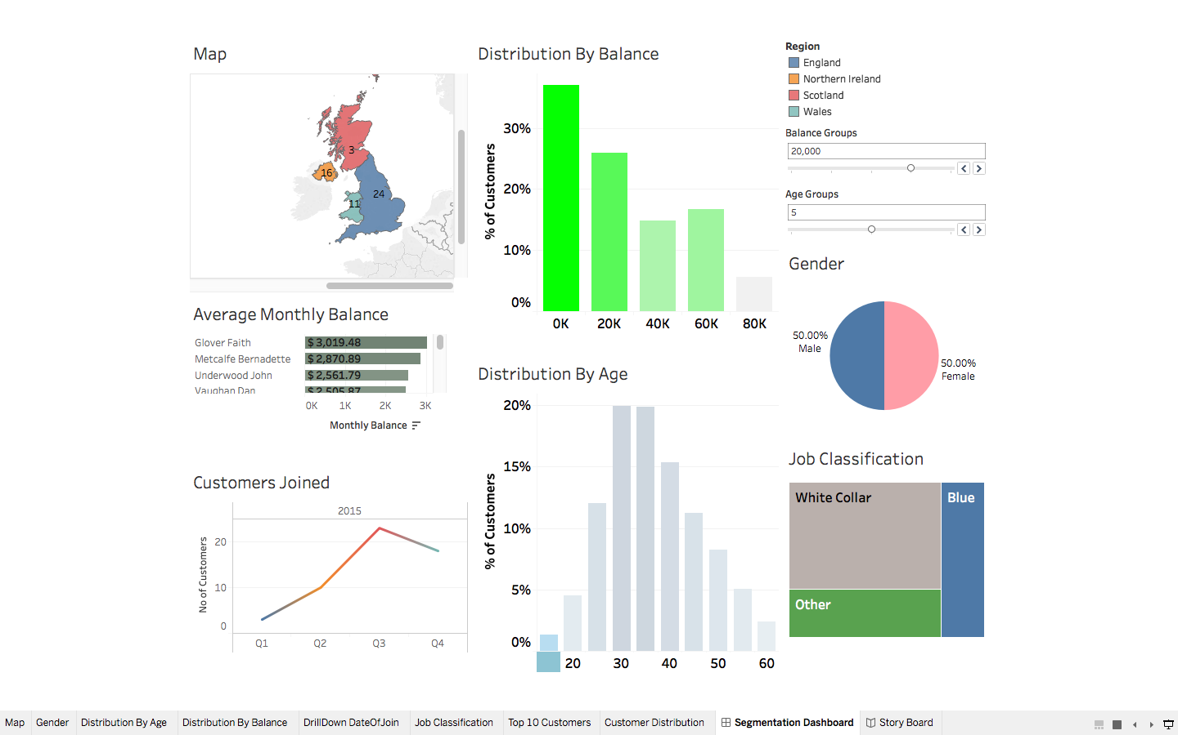
Dashboards
A dashboard is a consolidated display of many worksheets and related information in a single place. It is used to compare and monitor a variety of data simultaneously
When we modify a worksheet the dashboard is updated automatically and vice versa.
The different data views are displayed all at once

Slide 19
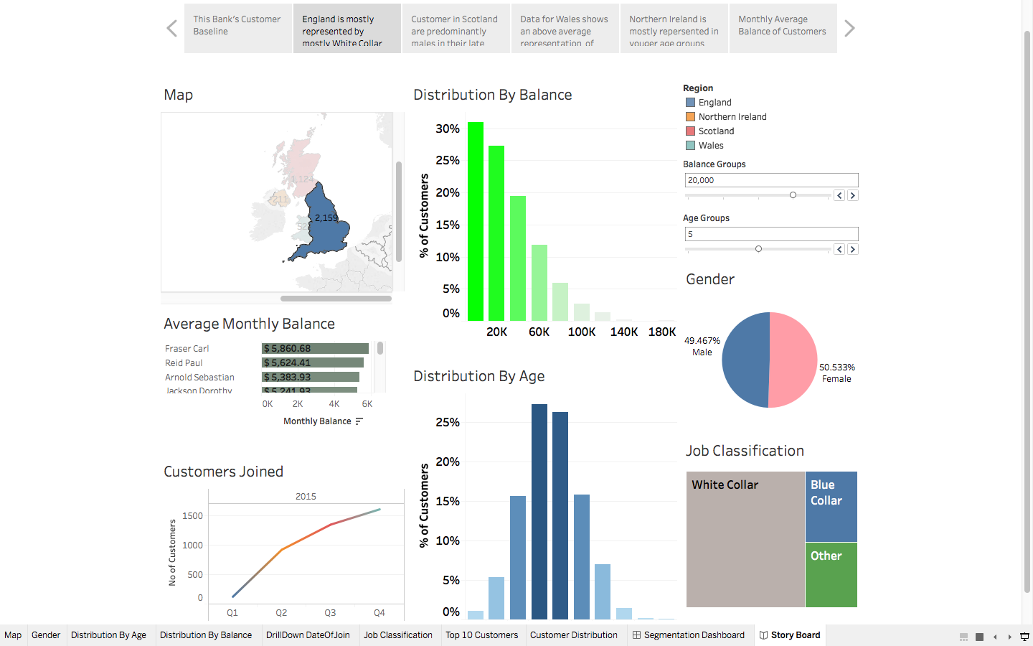
Data Stories
Tableau story points is also a dashboard in which you provide a narration of the visualizations.
Something like saying what we can observe from the visualizations. People tend to understand and remember concepts through stories. Using tableau you can tell a story with data, just as you can tell a story with text or with film.

Slide 20
Learning Curve

Slide 21
Our Learning Curve
Things to consider when doing Visualization projects:
What information to select for visualization
How to visualize it (Which Graph / Chart?)
Looking for datasets was quite tricky
Selecting what kind of information to mine from the data was tricky initially.
Challenges:
Interactive dashboards when using data blending values as filters did not work

Slide 22
Thank You

